Slide 1
MAXIMA AND MINIMA
OR
How can I do the best (or worst) I can?
One of the peculiarities of Mathematics is that it generally progresses when someone has a question
Is my farm bigger than yours? gave rise to
Geometry
How fast was that apple traveling? gave rise to
Newtonian Physics
What does one see if traveling at the speed of light? gave rise to
Relativity
Notes:
, …

Slide 2
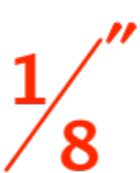
One could extend the list, and it would be fun to do so, but we have work to do.
Here is a question:
Take a standard 8”x11” sheet of paper.
Cut it into strips high. You will get either
64 strips, each 11” long or
88 strips, each 8” long.
Use the strips to surround as much ground as you can (do the best you can, remember?).
How would you cut the sheet?, ….. and
How much ground can you surround?

Slide 3
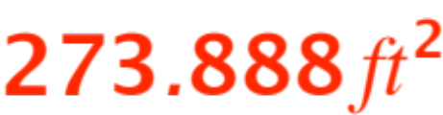
Let’s abstract the question, (that is
… eliminate the fluff !) You are given a length of
704” (the answer to the first question is …
… it doesn’t matter, you get a total length of 704”)
and are asked:
What shape in the plane has perimeter 704” and maximum possible area?
The answer is …
but I can’t show you why I am right, because the vagueness of the word “shape” forces me to use more math than you know.

Slide 4
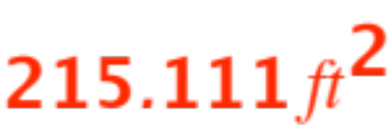

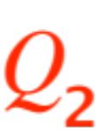
If however I restrict myself to
rectangular shapes
then I can give you the answer and be able to teach you how to get it yourself! By the way, the answer is .
The first lesson to be learned here is that
“the best (or worst) you can do” depends on
what restrictions you are subjected to.
Let’s abstract a little more.
A quantity depends on some other quantity
, the dependence being expressed by

Slide 5
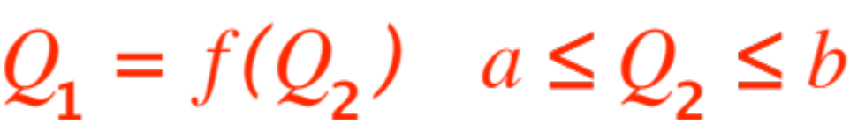
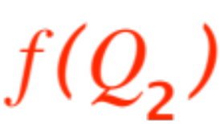
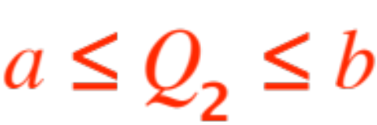
(The “restrictions” are expressed in the formula
, as well as the condition )
Our question becomes the following:
Given the function
What is the maximum (and/or minimum) values it can achieve?
That is what we are going to study today.
The first thing we will learn is that we have to be precise with our language (English or Tagalog or
any other human language is no match for math)

Slide 6
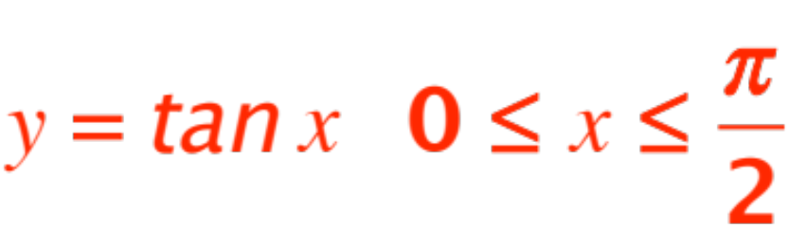
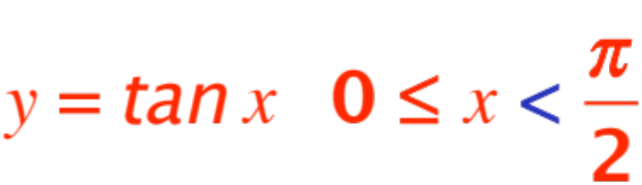
Here is a malformed question:
Given the function
What is the maximum (and/or minimum) values it can achieve?
The first trouble is that the function isn’t even defined at the rightmost end-point, and if we modify it by looking at
then we recognize that the minimum is 0, but
the maximum does not exist !!

Slide 7
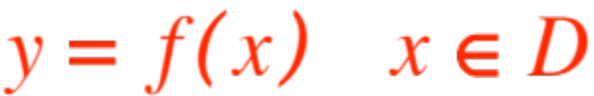
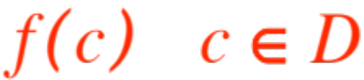


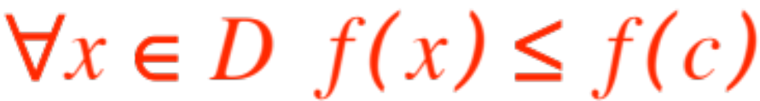

We need to make sure that we are trying to find something that
is there to be found !
Let’s start by clarifying our ideas.
Let
We say that the number is an
absolute maximum of over if
WARNING: there may be more than one where the function achieves its maximum.

Slide 8
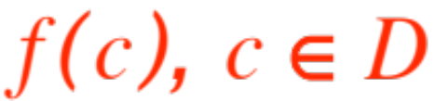
You define (or read it in the textbook) the notion of absolute minimum.
Clearly the idea of absolute maximum (and abso-lute minimum) depend on the domain .
If you enlarge the absolute maximum may
(that’s right) increase, and the absolute minimum
(that’s right) may decrease. What if shrinks?
We get the notion of local maximum, defined as follows:
Let
The value Is called a local maximum

Slide 9

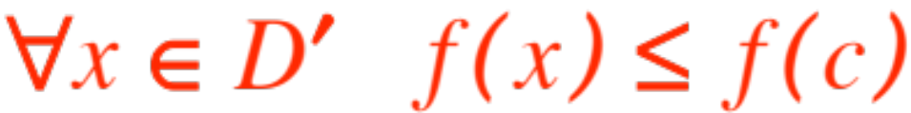


if for some subset
(your textbook calls “near” , I am being a little more precise.)
NOTE: A local maximum is an absolute maximum on a smaller domain!
Obviously an absolute maximum is also a local maximum, but not conversely (what does that mean?)
A symmetrical definition applies for local minima
(plural, from latin. You do it.)

Slide 10

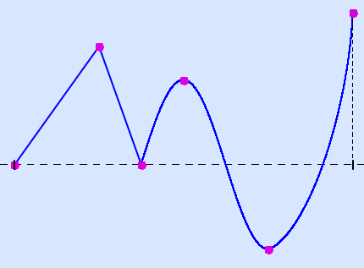





A little figure might help:
Let’s identify some points:
1 loc. min
2 loc. max
3 loc. min
4 loc. max
5 abs. min
6 abs. max

Slide 11
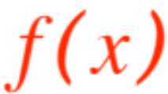
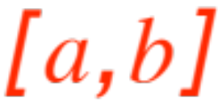
We have two jobs to do:
Make sure that what we are looking for is there to be found !
and
Once we know it is there, concoct a way to find it.
Job No. 1 is done by applying the
Theorem. (Extreme Value Theorem) Let
be continuous over the closed interval .
Then attains both an absolute maximum and an absolute minimum on .

Slide 12
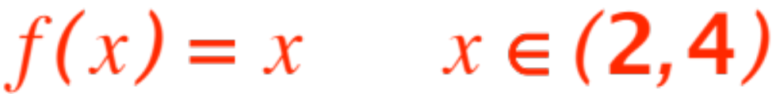
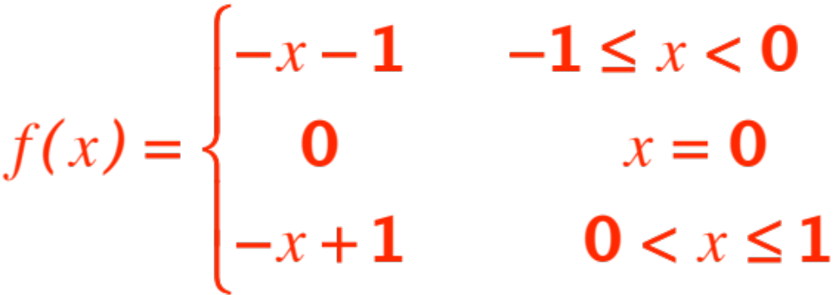
Note: If you drop either continuity or “closed interval” the theorem is false, as these two examples show:
the interval is not
closed
interval
closed, but
not contin.

Slide 13
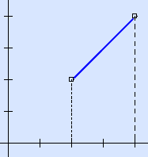
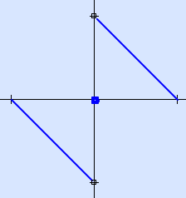

Here are the two graphs:

Slide 14
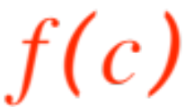
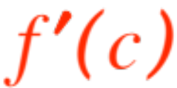

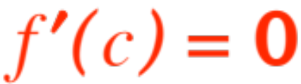
The Extreme Valute Theorem guarantees that what we seek is there to be found.
The theorem that helps us find it is:
Theorem (Fermat’s Theorem) Let be a local maximum (or minimum). Then
exists
The proof is easy and it is in the textbook, pp. 200-201.
NOTE: The converse of Fermat’s Theorem is false,
does NOT imply is a local maximum or minimum.

Slide 15
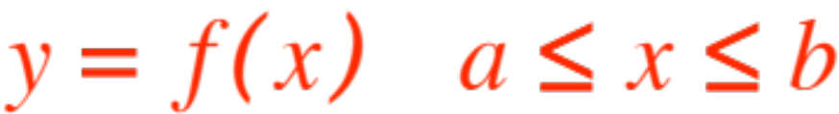

(it could be what you have called in High School
an inflection point.)
OK, let’s assume you have a function
that is continuous over the closed interval .
The Extreme Value Theorem tells us that attains both maximum and minimum in , so we are looking for something that .
The question now is:
How do we find those x-values in where
does attain its maximum? (minimum?)

Slide 16

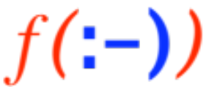
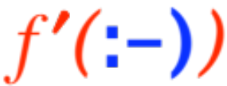

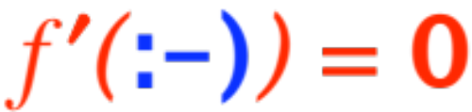
We know that the x-values we are looking for are either
end-points
local extremes
At any local extreme
either
i.
ii.
x-values that obey either i. or ii. above are called
“critical points”, so we conclude that

Slide 17
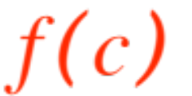
If is an absolute maximum (or minimum)
of the function over , then is
either an end-point or a critical point.
When life is normal, the set of points that are either end-points (two of them!) or critical points is finite.
Compute at all of them, by comparison you got both the absolute maximum and the abso-lute minimum!
VOILÁ

Slide 18
It is now time to do several exercises, at least the following recommended ones, on pp. 204 – 206 of the textbook.
3, 4, 31, 32, 34, 35, 38, 46, 49, 52, 57, 59b, 62b, 64, 67.
I wll add 1% to the homework score to everyone who hands in all 23 answers by 10/5.

